Slide 1
Standard template library

Slide 2
The C++ Standard Template Libraries
In 1990, Alex Stepanov and Meng Lee of Hewlett Packard Laboratories extended C++ with a library of class and function templates which has come to be known as the STL.
In 1994, STL was adopted as part of ANSI/ISO Standard C++.
Developed a set of general purpose templatized classes (data Structures) and functions (Algorithms) that could be used as a standard approach for storing and processing data
Collection of Generic classes and functions - STL

Slide 3
Standard Template Library
STL components are now part of standard c++ library defined in namespace std
The standard template library (STL) contains
  Containers
  Algorithms
  Iterators

Slide 4
Containers, Iterators, Algorithms
Algorithms use iterators to interact with objects
stored in containers
Container
Container
Iterator
Algorithm
Objects
Iterator
Algorithm
Iterator
Iterator
Algorithm

Slide 5
A container is a way that stored data is organized in memory,
-> an array of elements.
Algorithms in the STL are procedures that are applied to containers to process their data
        -> search for an element in an array
        -> sort an array.
        -> copying -> merging
Iterators are a generalization of the concept of pointers, they point to elements in a container
->increment an iterator to point to the next element in an array

Slide 6
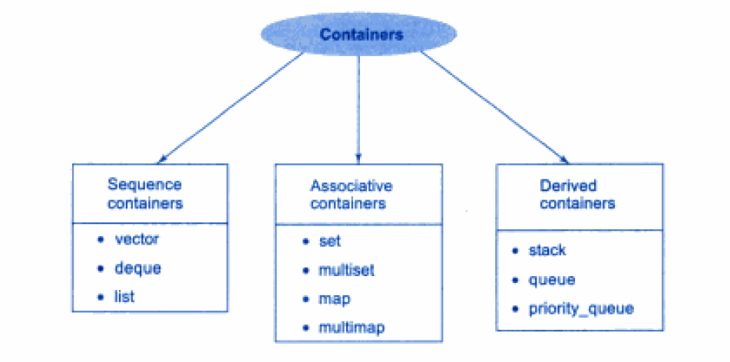
Containers supported by STL
Containers are objects that hold data

Slide 7
Sequence Containers
Can store elements is a linear sequence
Each element is related to other elements by its position along its line
STL provides 3 types of sequence containers
  Vector
  List
  deque

Slide 8
Associative containers
They are designed to support direct access to elements using keys
Not sequential
There are four types
  Set
  Multiset
  Map
  Multimap
Store data in a structure called tree which facilitates fast searching, deletion and insertion
Slow for random access and inefficient for sorting

Slide 9
Set and Multiset
  Store number of items and provide operations for manipulating them using the values as keys
  Difference between set and multiset
    Multiset allows duplicates , but set does not allow
  Map and multimap
    Used to store pairs of items – one called the key and the other called the value
  Difference between map and multimap
    Map allows only one key for a given value while multimap permits multiple keys

Slide 10
Derived Containers
They are
  Stack
  Queue
  priority_queue
Also called as container adaptors
Derived containers do not support iterators
They only support 2 members functions – push and pop for inserting and deleting operations

Slide 11
Draw backs with STL
Templates can lead to slower compile-times and possibly larger executable, especially with older compilers.
Compilers often produce incomprehensible error messages on code using templates.

Slide 12
Sequential Container : Vector
Provides an alternative to the built in array.
A vector is self grown.
Use It instead of the built in array!
The vector container (a C++ Standard Template) which is similar to an array with an exception that it automatically handles its own storage requirements in case it grows.

Slide 13
Defining & Creating a new vector
Syntax: vector<of what>
For example :
vector<int> - vector of integers.
vector<string> - vector of strings.
vector<int * > - vector of pointers to integers.
vector<Shape> - vector of Shape objects. Shape is a user defined class.
Using Vector:
#include <vector>
Two ways to use the vector type:
  Array style.
  STL style

Slide 14
Member Functions &Element Access
Here are following points to be noted related to various functions we used in the above example −
The push_back( ) member function inserts value at the end of the vector, expanding its size as needed.
The size( ) function displays the size of the vector.
The function begin( ) returns an iterator to the start of the vector.
The function end( ) returns an iterator to the end of the vector.
Accessing elements
at(g) – Returns a reference to the element at position ‘g’ in the vector
front() – Returns a reference to the first element in the vector
back() – Returns a reference to the last element in the vector

Slide 15
vectors
Member Functions push_back(), size(), and operator[]
#include <iostream>
#include <vector>
using namespace std;
int main()
{
vector<int> v; //create a vector of ints
v.push_back(10); //put values at end of array
v.push_back(11);
v.push_back(12);
v.push_back(13);
v[0] = 20; //replace with new values
v[3] = 23;
for(int j=0; j<v.size(); j++) //display vector contents
cout << v[j] << ‘ ‘; //20 11 12 23
cout << endl;
return 0;
}

Slide 16
Example - Member Functions swap(), empty(), back(), and pop_back()
#include <iostream>
#include <vector>
using namespace std;
int main()
{ //an array of doubles
double arr[] = { 1.1, 2.2, 3.3, 4.4 };
vector<double> v1(arr, arr+4); //initialize vector to array
vector<double> v2(4); //empty vector of size 4
v1.swap(v2); //swap contents of v1 and v2
while( !v2.empty() ) //until vector is empty,
{
cout << v2.back() << ‘ ‘; //display the last element
v2.pop_back(); //remove the last element
} //output: 4.4 3.3 2.2 1.1
cout << endl;
return 0;
}

Slide 17
Insert and erase
#include <iostream>
#include <vector>
using namespace std;
int main()
{
int arr[] = { 100, 110, 120, 130 }; //an array of ints
vector<int> v(arr, arr+4); //initialize vector to array
cout << “\nBefore insertion: “;
for(int j=0; j<v.size(); j++) //display all elements
cout << v[j] << ‘ ‘;
v.insert( v.begin()+2, 115); //insert 115 at element 2
cout << “\nAfter insertion: “;
for(j=0; j<v.size(); j++) //display all elements
cout << v[j] << ‘ ‘;
v.erase( v.begin()+2 ); //erase element 2
cout << “\nAfter erasure: “;
for(j=0; j<v.size(); j++) //display all elements
cout << v[j] << ‘ ‘; return 0; }

Slide 18
// CPP program to illustrate push_back() function
#include <iostream>
#include <vector>
using namespace std;
int main()
{
vector<int> myvector{ 1, 2, 3, 4, 5 };
myvector.push_back(6);
cout<< “current size = ” << myvector.size() << “\n”;
for (vector<int>::iterator it = myvector.begin(); it != myvector.end(); ++it)
cout << ' ' << *it;
myvector.pop_back();
for (vector<int>::iterator it = myvector.begin(); it != myvector.end(); ++it)
cout << ' ' << *it;
}

Slide 19
Vector – cont…
//inserting element
//using an iterator to access the vector elements, declares itr and makes it to point to the first position of the vector
Vector<int> :: iterator it = myvector.begin();
it = it +3;
//myvector.insert(iterator position, nooflements, val to be inserted)
myvector.insert(it,1,9)
//removing 4th and 5th element
myvector.erase(myvector.begin()+3,myvector()+5);

Slide 20
Example
#include <iostream>
#include <vector>
using namespace std;
int main()
{
// create a vector to store int
vector<int> vec;
int i;
// display the original size of vec
cout << "vector size = " << vec.size()
<< endl;
// push 5 values into the vector
for(i = 0; i < 5; i++){
vec.push_back(i);
}
// display extended size of vec
cout << "extended vector size = " << vec.size()
<< endl;
// access 5 values from the vector
for(i = 0; i < 5; i++){
cout << "value of vec [" << i << "] = " << vec[i]
<< endl;
}
// use iterator to access the values
vector<int>::iterator v = vec.begin();
while( v != vec.end()) {
cout << "value of v = " << *v << endl;
v++;
}
return 0;
}

Slide 21
List
An STL list container is a doubly linked list, in which each element contains a pointer not only to the next element but also to the preceding one. The container stores the address of both the front (first) and the back (last) elements, which makes for fast access to both ends of the list.
Lists are appropriate when you will make frequent insertions and deletions in the middle of the list.
Not suitable for random access , only vector or deque is suitable for random access

Slide 22
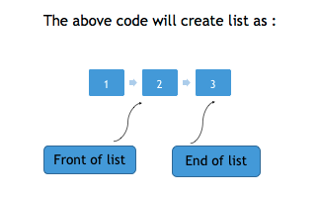
List
Array and Vector are contiguous containers, i.e they store their data on continuous memory, thus the insert operation at the middle of vector/array is very costly (in terms of number of operation and process time) because we have to shift all the elements, linked list overcome this problem. Linked list can be implemented by using the list container
#include <iostream>
#include <list>
int main()
{
std::list<int> l1;
/* Creates a new empty linked list l1 */
std::list<int> l(1,2,3);
}

Slide 23
Insert
:
Member
function
•
This method, as the name suggests, inserts an element at specific
position,
follows :
in
a
list.
There
are
3
variations
of insert(),
they
are
as
•
insert(iterator,
element)
:
inserts element
in
the
list
before
the
position pointed by the iterator.
•
insert(iterator,
count,
element)
:
the
inserts
element
in
the
list
of
before
times.
the
position
pointed
by
iterator, count
number
•
insert(iterator, start_iterator, end_iterator) : insert
the element
end_iterator
pointed
by
start_iterator
to
the
element
pointed
by
before the position pointed by iterator
18

Slide 24
Example
1
List
#include <iostream>
#include <list>
using namespace std;
int main()
{
list<int> l = {1,2,3,4,5};
list<int>::iterator it = l.begin();
l.insert (it+1, 100); // insert 100 before 2 position
/* now the list is 1 100 2 3 4 5 */
list<int> new_l = {10,20,30,40}; // new list new_l.insert (new_l.begin() , l.begin(), l.end());
/* insert elements from beginning of list l to end of list l
before 1 position in list new_l */
/* now the list new_l is 1 100 2 3 4 5 10 20 30 40 */
l.insert(l.begin() , 5 , 10); // insert 10 before beginning 5 times
/* now l is 10 10 10 10 10 1 100 2 3 4 5 */
return 0;
}
19

Slide 25

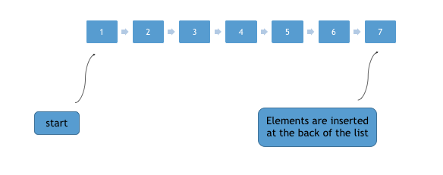
push_back
•
push_back(element)
method
is
used
to
push
elements
into
a
list
from
the
back.
20

Slide 26

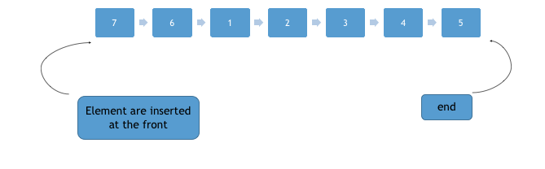
push_front
•
push_front(element)
method
is
used
to
push
elements
into
a
list
from
the
front.
21

Slide 27
Example
2
List
#include <iostream>
#include <list>
using namespace std;
int main()
{
list<int> l{1,2,3,4,5};
l.push_back(6);
l.push_back(7);
/* now the list becomes 1,2,3,4,5,6,7 */
l.push_front(8);
l.push_front(9);
/* now the list becomes 9,8,1,2,3,4,5,6,7 */
}
22

Slide 28
pop_back
and pop_front
•
pop_front()
pop_back()
removes
removes
first
first
element
from
the
start
of
the
the
list.
list.
While
element
from
the
end
of
#include <iostream>
#include <list>
using namespace std;
int main()
{
list<int> l{1,2,3,4,5};
l.pop_back()();
/* now the list becomes 1,2,3,4 */
l.pop_front()();
/* now the list becomes 2,3,4 */
}
23

Slide 29
Other
functions
•
empty
false.
:
This
method
returns
true
if
the
list
is
empty
else
returns
•
size
:
This
method
can be
used
to
find
the
number
of elements
present in the list.
•
front
and
back
:
front()
is
used
to
get
the
first
element
of the list
from the start while back() is used to get the first element of the list
from the back.
swap: Swaps two list, if there is exception thrown while swapping
•
any
element,
swap() throws
exception.
Both lists
which
are to be
swapped
must be
of
the same
type,
i.e
you
can’t
swap
list
of
an
integer with list of strings.
reverse: This method can be used to reverse a list completely.
•
•
sort:
sort method sorts the given list. It does not create new sorted
list
but
changes
the
position
of
elements
within
an
existing
list
to
sort it.
24

Slide 30
Vector vs. List
By default, use a vector
  You need a reason not to
  You can “grow” a vector (e.g., using push_back())
  You can insert() and erase() in a vector
  Vector elements are compactly stored and contiguous
  For small vectors of small elements all operations are fast
    compared to lists
If you don’t want elements to move, use a list
  You can “grow” a list (e.g., using push_back() and push_front())
  You can insert() and erase() in a list
  List elements are separately allocated
Note that there are more containers, e.g.,
  map
  unordered_map

Slide 31
Member Functions push_front(), front(), and pop_front
#include <iostream>
#include <list>
using namespace std;
int main()
{
list<int> ilist;
ilist.push_back(30); //push items on back
ilist.push_back(40);
ilist.push_front(20); //push items on front
ilist.push_front(10);
int size = ilist.size(); //number of items
for(int j=0; j<size; j++)
{
cout << ilist.front() << ‘ ‘; //read item from front
ilist.pop_front(); //pop item off front
}
cout << endl; return 0; }

Slide 32
Member Functions reverse(), merge(), and unique()
#include <iostream>
#include <list>
using namespace std;
int main()
{
int j;
list<int> list1, list2;
int arr1[] = { 40, 30, 20, 10 };
int arr2[] = { 15, 20, 25, 30, 35 };
for(j=0; j<4; j++)
list1.push_back( arr1[j] ); //list1: 40, 30, 20, 10
for(j=0; j<5; j++)
list2.push_back( arr2[j] ); //list2: 15, 20, 25, 30, 35

Slide 33
list1.reverse(); //reverse list1: 10 20 30 40
list1.merge(list2); //merge list2 into list1
list1.unique(); //remove duplicate 20 and 30
int size = list1.size();
while( !list1.empty() )
{
cout << list1.front() << ‘ ‘; //read item from front
list1.pop_front(); //pop item off front
}
cout << endl;
return 0;
}

Slide 34
deque
A deque is like a vector in some ways and like a linked list in others. Like a vector, it supports random access using the [] operator. However, like a list, a deque can be accessed at the front as well as the back. It’s a sort of double-ended vector, supporting push_front(), pop_front(), and front().
Syntax for creating vector
deque< object_type > deque_name;
A vector always occupies a contiguous region of memory. If a vector grows too large, it may need to be moved to a new location where it will fit.
A deque, on the other hand, can be stored in several non-contiguous areas; it is segmented.

Slide 35
Member Functions
of
Deque
•
•
•
•
push_back, push_front and
pop_back and pop_front swap
insert
empty,
size
and
max_size
26

Slide 36
Example
1
#include <iostream>
#include <deque>
#include <vector>
using namespace std;
int main ()
{
int a[] = { 1,5,8,9,3 };
deque<int> dq(a, a+5);
/* creates s deque with elements 1,5,8,9,3 */
dq.push_back(10);
/* now dq is : 1,5,8,9,3,10 */
dq.push_front(20);
/* now dq is : 20,1,5,8,9,3,10 */
deque<int>::iterator i;
i=dq.begin()+2;
/* i points to 3rd element in dq */
dq.insert(i,15);
/* now dq 20,1,15,5,8,9,3,10 */
int a[]={7,7,7,7};
d1.insert(dq.begin() , a , a+4 );
/* now dq is 7,7,7,7,20,1,15,5,8,9,3,10 */
}
27

Slide 37
Example
2
#include <iostream>
#include <deque>
#include <vector>
using namespace std;
int main ()
{
int a[] = { 1,5,8,9,3,5,6,4 };
deque<int> dq(a,a+8);
/* creates s deque with elements 1,5,8,9,3,5,6,4 */
dq.pop_back();
/* removes an element from the back */
/* now the deque dq is : 1,5,8,9,3,5,6 */
dq.pop_front();
/* now dq is : 1,5,8,9,3,5,6 */
}
28

Slide 38
#include <iostream>
#include <deque>
using namespace std;
int main()
{
deque<int> deq;
deq.push_back(30); //push items on back
deq.push_back(40);
deq.push_back(50);
deq.push_front(20); //push items on front
deq.push_front(10);
deq[2] = 33; //change middle item
for(int j=0; j<deq.size(); j++)
cout << deq[j] << ‘ ‘; //display items
cout << endl;
return 0; }

Slide 39
Stack
Stacks are a type of container adaptors with LIFO(Last In First Out) type of working, where a new element is added at one end and (top) an element is removed from that end only.
The functions associated with stack are:
empty() – Returns whether the stack is empty
size() – Returns the size of the stack
top() – Returns a reference to the top most element of the stack
push(g) – Adds the element ‘g’ at the top of the stack
pop() – Deletes the top most element of the stack

Slide 40
Stack
int main ()
{
stack <int> s;
s.push(10);
s.push(30);
s.push(20);
s.push(5);
s.push(1);
cout << "The stack is : ";
showstack(s);
cout << "\ns.size() : " << s.size();
cout << "\ns.top() : " << s.top();
cout << "\ns.pop() : ";
s.pop();
showstack(s);
return 0;
}
// CPP program to demonstrate working of STL stack
#include <iostream>
#include <stack>
using namespace std;
void showstack(stack <int> s)
{
while (!s.empty())
{
cout << '\t' << s.top();
s.pop();
}
cout << '\n';
}

Slide 41
Algorithms
Retrieve or Non-mutating Algorithms
Mutating Algorithms
Sorting Algorithms
Set Algorithms
Relational Algorithms

Slide 42
Non Mutating Algorithms
Adjacent_find –adj pairs
Count-occurrence of a value
Count_if—no.of elements that matches a predicate
Equal-if two ranges are equal
Find-first occurrence of a value
Find_end
Find_first_of()
Find_if()- find the elements that matches a predicate
For_each()- apply an operation to each element
Mismatch()
Search_ch()
Search_n()

Slide 43
Mutating Algorithms
Copy()
Copy_backward()

Slide 44
Algorithms : find()
InputIterator find (InputIterator first, InputIterator last, const T& val);
The find() algorithm looks for an element matching val between start and end.
If an element matching val is found, the return value Is an iterator that points to that element. Otherwise, the return value is an iterator that points to end.
#include <iostream>
#include <algorithm>
using namespace std;
int main () {
int myints[] = { 10, 20, 30, 40 };
int * p = find (myints, myints+4, 30);
if (p != myints+4) cout << "Element found in myints: " << *p << '\n';
else cout << "Element not found in myints\n“;
return 0; }

Slide 45
Find() Algorithm
#include <vector>
#include <algorithm>
#include <iostream>
int key;
int arr[] = { 12, 3, 17, 8, 34, 56, 9 }; // standard C array
vector<int> v(arr, arr+7); // initialize vector with C array
vector<int>::iterator iter;
cout << ”enter value :”;
cin >> key;
iter=find(v.begin(),v.end(),key); // finds integer key in v
if (iter != v.end()) // found the element
cout << ”Element ” << key << ” found” << endl;
else
cout << ”Element ” << key << ” not in vector v” << endl;

Slide 46
Find_If() Algorithm
#include <vector>
#include <algorithm>
#include <iostream>
Bool mytest(int n) { return (n>21) && (n <36); };
int arr[] = { 12, 3, 17, 8, 34, 56, 9 }; // standard C array
vector<int> v(arr, arr+7); // initialize vector with C array
vector<int>::iterator iter;
iter=find_if(v.begin(),v.end(),mytest);
// finds element in v for which mytest is true
if (iter != v.end()) // found the element
cout << ”found ” << *iter << endl;
else
cout << ”not found” << endl;

Slide 47
Algorithm: count()
count() returns the number of elements in the given range that are equal to given value.
Syntax for count is:
count(first ,last ,value) : This will return number of the element in range defined
by iterators first and last ( excluded ) which are equal ( == ) the value
#include <iostream>
#include <algorithm>
#include <vector>
using namespace std;
int main ()
{
int values[] = {5,1,6,9,10,1,12,5,5,5,1,8,9,7,46};
int count_5 = count(values, values+15, 5);
/* now count_5 is equal to 4 */
vector<int> v(values, values+15);
int count_1 = count(v.begin(), v.end(), 1);
/* now count_1 is equal to */
return 0;
}

Slide 48
Count_If() Algorithm
#include <vector>
#include <algorithm>
#include <iostream>
Bool mytest(int n) { return (n>14) && (n <36); };
int arr[] = { 12, 3, 17, 8, 34, 56, 9 }; // standard C array
vector<int> v(arr, arr+7); // initialize vector with C array
int n=count_if(v.begin(),v.end(),mytest);
// counts element in v for which mytest is true
cout << ”found ” << n << ” elements” << endl;

Slide 49
Algorithms :
search
•
This function is used to perform searches for a given sequence in a
given range. There are two variations of the search():
•
search(first1
,last1 ,first2
,last2) :
This
function
searches
for
the
and
sequence
defined by
first2
and
last2
in
the
range
first1
last1(where last1 is excluded). If there is
a match an iterator to the
first element of the sequence in the range [first1,last1] is returned,
else iterator to last1 is returned.
•
search(first1
cmp_function
,last1
,first2
,last2 ,cmp_functions)
: Here
is
used
to
decide
how
to
check
the
equality
of
two
and
elements,
objects.
it
is
useful
for
non-numeric
elements
like
strings
7

Slide 50
Algorithms
:
Search
Example
1
#include<iostream>
#include<algorithm>
#include<vector>
using namespace std;
int main()
{
int inputs1[] = { 1,2,3,4,5,6,7,8};
int inputs2[] = { 2,3,4};
vector<int> v1(inputs1, inputs1+9);
vector<int> v2(inputs2, inputs2+3);
vector<int>::iterator i ,j;
i = search(v1.begin(), v1.end(), v2.begin(), v2.end());
/* now i points to the second element in v1 */
j = search(v1.begin()+2, v1.end(), v2.begin(), v2.end());
/* j now points to the end of v1 as no sequence is equal to 2,3,4 in
[v1.begin()+2 ,v1.end()] */
}
8

Slide 51
Algorithms
:
sort()
•
This
function of
the
STL,
sorts
the
contents
of
the
given
range.
There are two version of sort() :
•
sort(start_iterator,
end_iterator
)
: sorts
the
range
defined
by
iterators start_iterator and end_iterator in ascending order.
•
sort(start_iterator,
end_iterator,
compare_function)
:
this
also
sorts
done
the given range but you
can
define
how
the
sorting
should
be
by
compare_function.
9

Slide 52
Algorithms
:
sort()
Example
1
#include<iostream>
#include<algorithm>
#include<vector>
using namespace std;
bool compare_function(int i, int j)
{
return i > j; // return 1 if i>j else 0
}
bool compare_string(string i, string j)
{
return (i.size() < j.size());
}
int main()
{
int arr[5] = {1,5,8,4,2};
sort(arr , arr+5);
// sorts arr[0] to arr[4] in ascending order
/* now the arr is 1,2,4,5,8 */
vector<int> v1;
v1.push_back(8);
v1.push_back(4);
v1.push_back(5);
v1.push_back(1);
/* now the vector v1 is 8,4,5,1 */
i = v1.begin(); // i now points to beginning of the vector v1
sort(i,j); //sort(v1.begin() , v1.end() ) can also be used
/* use of compare_function */
sort(a2,a2+9,compare_function); // sorts a2 in descending order
that result into sorting in descending order */
/* compare_function is also used to sort
non-numeric elements such as*/
string s[]={"a" , "abc", "ab" , "abcde"};
sort(s,s+4,compare_string);
}
vector<int>::iterator i, j;
j = v1.end();
// j now points to end of the vector v1
/* now the vector v1 is 1,4,5,8 */
int a2[] = { 4,3,6,5,6,8,4,3,6 };
/* here we have used compare_function which uses
operator(>),
/* now s is "a","ab","abc","abcde" */
10

Slide 53
Algorithm: merge()
Combines the elements in the sorted ranges [first1,last1) and [first2,last2), into a new range beginning at result with all its elements sorted.
Syntax: OutputIterator merge (InputIterator1 first1, InputIterator1 last1, InputIterator2 first2, InputIterator2 last2, OutputIterator result);
#include <iostream>
#include <algorithm>
#include <vector>
using namespace std;
int main () {
int first[] = {5,10,15,20,25};
int second[] = {50,40,30,20,10};
vector<int> v(10);
sort (first,first+5);
sort (second,second+5);
merge (first,first+5,second,second+5,v.begin());
cout << "The resulting vector contains:";
for (std::vector<int>::iterator it=v.begin(); it!=v.end(); ++it)
cout << ' ' << *it; std::cout << '\n'; return 0; }

Slide 54
for_each
#include <iostream>
#include <algorithm>
using namespace std;
void in_to_cm(double); //declaration
int main()
{ //array of inches values
double inches[] = { 3.5, 6.2, 1.0, 12.75, 4.33 };
//output as centimeters
for_each(inches, inches+5, in_to_cm);
cout << endl;
return 0;
}
void in_to_cm(double in) //convert and display as centimeters
{
cout << (in * 2.54) << ‘ ‘;
}
The output looks like this:
8.89 15.748 2.54 32.385 10.9982}
Syntax :
Function for_each (InputIterator first, InputIterator last, Function fn);
The for_each() algorithm allows you to do something to every item in a container. You write your own function to determine what that “something” is. Your function can’t change the elements in the container, but it can use or display their values.
11

Slide 55
Transform()
#include <iostream>
#include <algorithm>
using namespace std;
int main()
{ //array of inches values
double inches[] = { 3.5, 6.2, 1.0, 12.75, 4.33 };
double centi[5];
double in_to_cm(double); //prototype
//transform into array centi[]
transform(inches, inches+5, centi, in_to_cm);
for(int j=0; j<5; j++) //display array centi[]
cout << centi[j] << ‘ ‘;
cout << endl;
return 0;
}
double in_to_cm(double in) //convert inches to centimeters
{
return (in * 2.54); //return result
}
The transform() algorithm does something to every item in a container, and places the resulting values in a different container (or the same one).
Again, a user-written function determines what will be done to each item. The return type of this function must be the same as that of the destination container.
Syntax:
OutputIterator transform (InputIterator first1, InputIterator last1, OutputIterator result, UnaryOperation op);

Slide 56
Iterators
Iterator behave like pointers and are used to access container elements
Used to traverse from one element to another , a process known as iterating through the container
5 types of iterators
  Input
  Output
  Forward
  Bidirectional
  Random

Slide 57
Iterator Categories
Input and output iterators are the most limited types of iterators: they can perform sequential single-pass input or output operations.
Forward iterators have all the functionality of input iterators and -if they are not constant iterators- also the functionality of output iterators, although they are limited to one direction in which to iterate through a range (forward). All standard containers support at least forward iterator types.
Bidirectional iterators are like forward iterators but can also be iterated through backwards.
Random-access iterators implement all the functionality of bidirectional iterators, and also have the ability to access ranges non-sequentially: distant elements can be accessed directly by applying an offset value to an iterator without iterating through all the elements in between.

Slide 58

Iterators
Syntax
std::class_name<template_parameters>:: iterator itname
where itname - name of the iterator, class_name - name of the STL container, template_parameters - parameters to the template, and finally, std - namespace having collection of STL classes

Slide 59
Iterators - Data Access
iterator values are returned by a container’s begin() and end() member functions
In containers that provide random access iterators (vector and queue) it’s easy to iterate through the container using the [] operator. Containers such as lists, which don’t support random access, require a different approach.

Slide 60
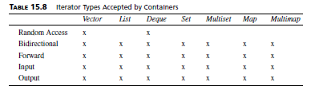

Slide 61
Defining
an
iterator
•
Syntax
for
defining
an
iterator
is
:
container_type <parameter_list>::iterator iterator_name;
#include<iostream>
#include<vector>
using namespace std;
int main()
{
vector<int>::iterator i;
/* create an iterator named i to a vector of integers */
vector<string>::iterator j;
/* create an iterator named j to a vector of strings */
list<int>::iterator k;
/* create an iterator named k to a vector of integers */
map<int, int>::iterator l;
/* create an iterator named l to a map of integers */
}

Slide 62
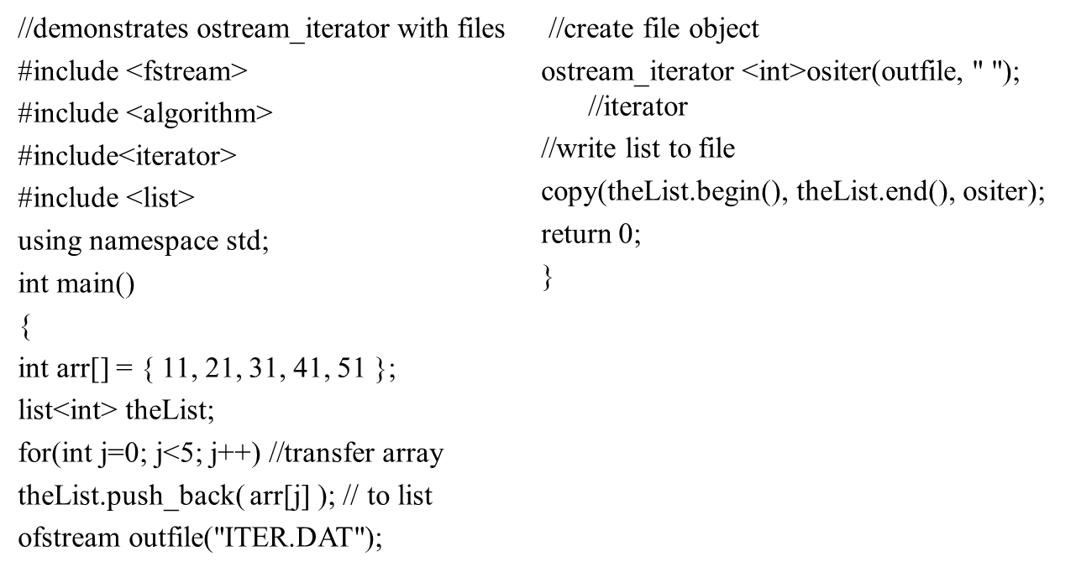
Output Iterator – Writing the list to file

Slide 63
Iterators
can
be
used
to
traverse
the
container
#include<iostream>
#include<vector>
int main()
{
vector<int> v(10);
/* creates an vector v : 0,0,0,0,0,0,0,0,0,0 */
vector<int>::iterator i;
for(i = v.begin(); i! = v.end(); i++)
cout << *i <<" “;
/* in the above for loop iterator I iterates though the vector v and *operator is used of printing the element pointed by it. */
return 0;
}

Slide 64
Operations
on
Iterators
in
can
STL
•
Following
are
the
operations
that
be
used
with
Iterators
to
perform various
actions.
begin() - This function is used to return the beginning position of the container.
end() - This function is used to return the end position of the container.
advance()- This function is used to increment the iterator position till the specified number mentioned in its arguments.
next() - This function returns the new iterator that the iterator would point after advancing the positions mentioned in its arguments.
prev() - This function returns the new iterator that the iterator would point after decrementing the positions mentioned in its arguments.
Distance() – returns distance between two fast and last iterator

Slide 65
#include <iostream>
#include <list>
#include <algorithm>
using namespace std;
int main()
{
int arr[] = { 2, 4, 6, 8 };
list<int> theList;
for(int k=0; k<4; k++) //fill list with array elements
theList.push_back( arr[k] );
list<int>::iterator iter; //iterator to list-of-ints
for(iter = theList.begin(); iter != theList.end(); iter++)
cout << *iter << ‘ ‘; //display the list
cout << endl;
return 0;
}

Slide 66
advance() iterator
#include<iostream>
#include<iterator> // for iterators
#include<vector> // for vectors
using namespace std;
int main()
{ vector<int> ar = { 1, 2, 3, 4, 5 };
// Declaring iterator to a vector
vector<int>::iterator ptr = ar.begin();
// Using advance() to increment iterator position points to 4
advance(ptr, 3);
// Displaying iterator position
cout << "The position of iterator after advancing is : ";
cout << *ptr << " ";
return 0;
}

Slide 67
distance()
Operation
•
It
will
return
the
number
of
elements
or
we
can
say
distance
between
the
first
and
the
last
iterator.
distance(iterator first, iterator last)
#include<iostream>
#include<vector>
int main()
{
vector<int> v(10) ; // create a vector of 10 0's
vector<int>::iterator i, j; // defines iterators i,j to the vector of integers
i = v.begin();
/* i now points to the beginning of the vector v */
j = v.end();
/* j now points to the end() of the vector v */
cout << distance(i,j) << endl;
/* prints 10 , */
}
37

Slide 68
Example
C++ Algorithm next_permutation() function is used to reorder the elements in the range [first, last) into the next lexicographically greater permutation.
bool next_permutation (BidirectionalIterator first,
BidirectionalIterator last);
Parameters:
first, last : Bidirectional iterators to the initial and final positions of the sequence.

Slide 69
Example
#include <iostream>
#include <algorithm>
#include <string>
using namespace std;
int main() {
string s;
cin >>s ;
sort(s.begin(),s.end());
do
{
cout << s<<"\n";
} while (next_permutation(s.begin(),s.end()));
return 0;
}

Slide 70
Associative container - Set
Sequence containers (vector, list, and deque) store data items in a fixed linear sequence. Finding an item in such a container will involve the slow process of stepping through the items in the container one by one.
In an associative container the items are not arranged in sequence.This arrangement is typically a tree structure.
The two main categories of associative containers in the STL are sets and maps.
A set stores objects containing keys. A map stores pairs, where the first part of the pair is an object containing a key and the second part is an object containing a value.

Slide 71
algorithms, such as lower_bound() and equal_range(), exist only for associative containers
In both a set and a map, only one example of each key can be stored. It’s like a dictionary that forbids more than one entry for each word
A multiset and a multimap are similar to a set and a map,but can include multiple instances of the same key.

Slide 72
Associative Container
Associative containers implement sorted data structures that can be quickly searched (O(log n) complexity).
Set collection of unique keys, sorted by keys
map collection of key-value pairs, sorted by keys, keys are unique
Multiset collection of keys, sorted by keys
Multimap collection of key-value pairs, sorted by keys

Slide 73
The Pair Template
A class that holds a pair of items (may be of different types)
  template <typename T1, typename T2>
  class Pair {
  public:
  T1 first;
  T2 second;
  Pair() {};
  Pair(const T1& t1, const T2& t2): first(t1), second(t2) {};
  };
Examples
  Pair<int, int> pair1;
  Pair<string, int> pair2;
C++/STL
#include <utility>
pair<int, int> pair1
pair<string, int> pair2

Slide 74
The STL Set Template
set() // Creates an empty set.
set(const key_compare& comp) //Creates an empty set, use comp for key comparison
pair<iterator, bool> insert(const value_type& x)
iterator insert(iterator pos, const value_type& x)
  Inserts x into the set, using pos as a hint to where it will be inserted.
void erase(iterator pos)
  Erases the element pointed to by pos.
size_type erase(const key_type& k)
  Erases the element whose key is k
void erase(iterator first, iterator last)
  Erases all elements in a range
iterator find(const key_type& k) const
  Finds an element whose key is k
Logarithmic complexity for insertion, remove, search

Slide 75
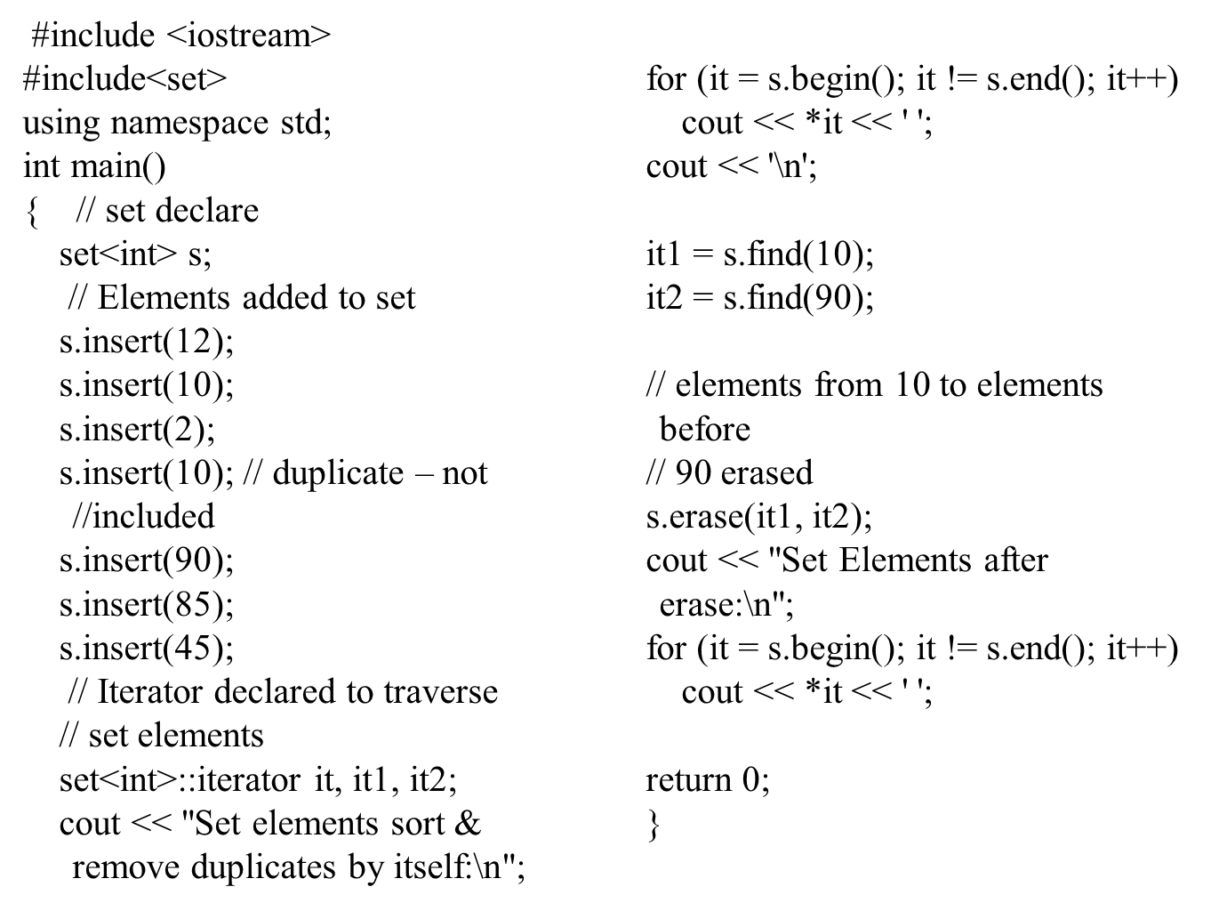
Set Example

Slide 76
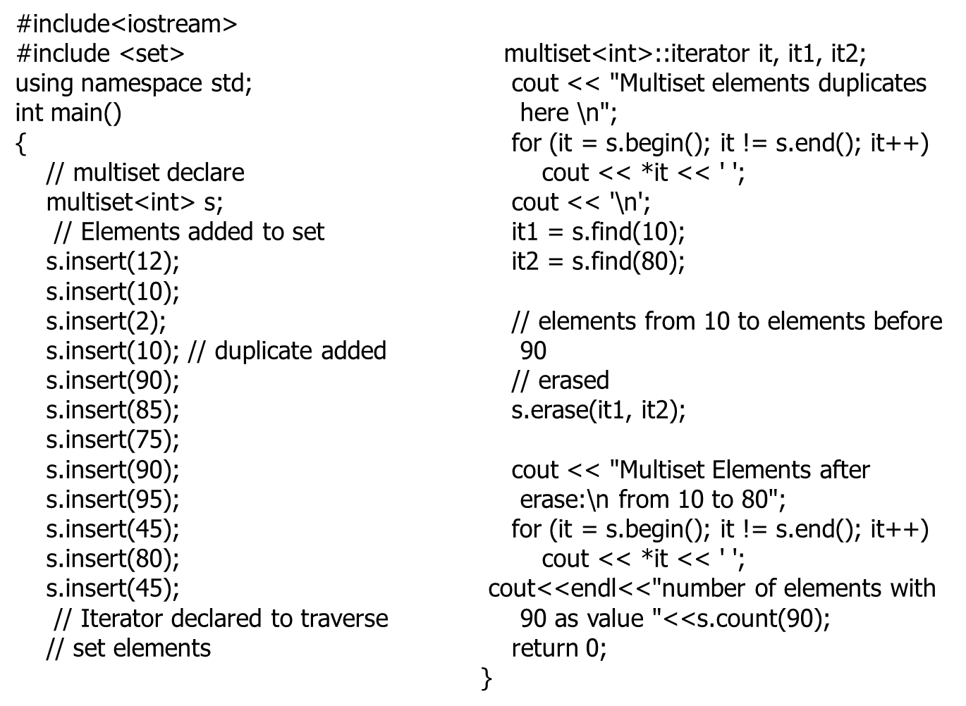
Multi Set Example

Slide 77
Maps
Associative container that associates objects of type Key with objects of type Data
  Sorted according to keys
Map
  Stores (key, object) pairs
  Unimodal: duplicate keys not allowed
  AKA: table, associative array

Slide 78
The STL Map Template
map()
map(const key_compare& comp)
pair<iterator, bool> insert(const value_type& x)
  Inserts x into the map
iterator insert(iterator pos, const value_type& x)
  Inserts x into the map, using pos as a hint to where it will be inserted
void insert(iterator, iterator)
  Inserts a range into the map

Slide 79
STL Map Template
void erase(iterator pos)
  Erases the element pointed to by pos
size_type erase(const key_type& k)
  Erases the element whose key is k
void erase(iterator first, iterator last)
  Erases all elements in a range
iterator find(const key_type& k)
  Finds an element whose key is k.
data_type& operator[](const key_type& k)
  Returns a reference to the object that is associated with a particular key.
  If the map does not already contain such an object, operator[] inserts the default object data_type()

Slide 80
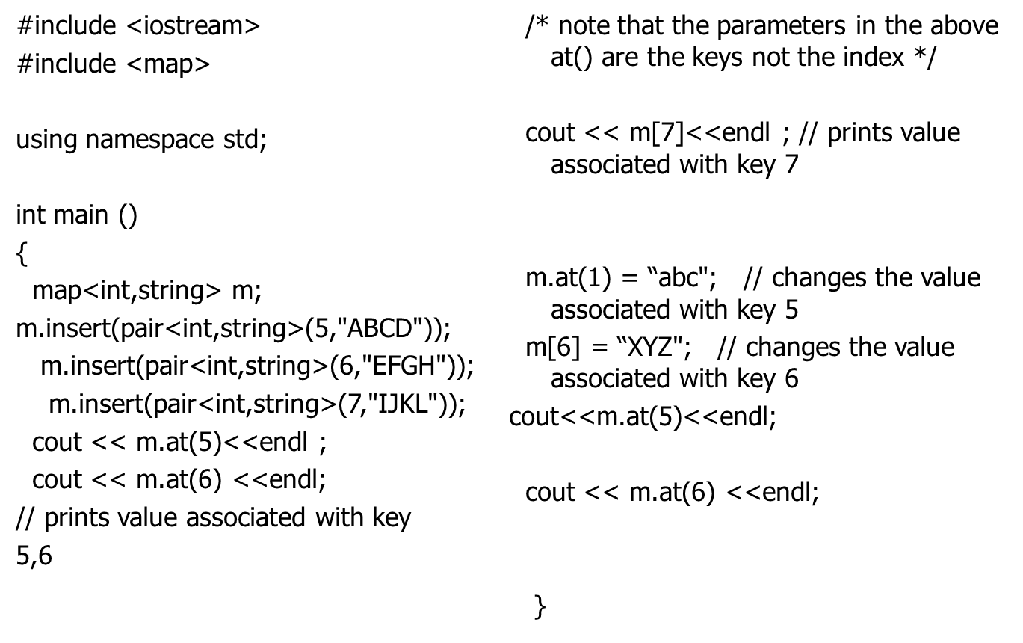
Example Maps

Slide 81
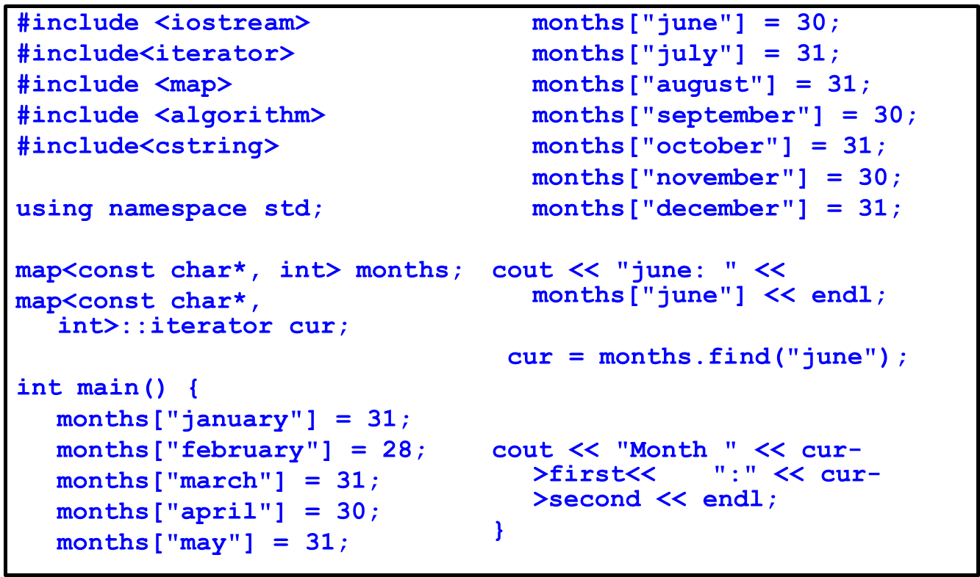
Map Usage Example

Slide 82
#include <iostream>
#include <map>
#include <iterator>
using namespace std;
int main()
{
multimap <int, int> gquiz1;
// empty multimap container
// insert elements in random order
gquiz1.insert(pair <int, int> (1, 40));
gquiz1.insert(pair <int, int> (2, 30));
gquiz1.insert(pair <int, int> (3, 60));
gquiz1.insert(pair <int, int> (4, 20));
gquiz1.insert(pair <int, int> (5, 50));
gquiz1.insert(pair <int, int> (6, 50)); gquiz1.insert(pair <int, int> (6, 10));
// printing multimap gquiz1
multimap <int, int> :: iterator itr;
cout << "\nThe multimap gquiz1 is : \n";
cout << "\tKEY\tELEMENT\n";
for (itr = gquiz1.begin(); itr != gquiz1.end(); ++itr)
{
cout << '\t' << itr->first << '\t' << itr->second << '\n';
}
cout << endl;
gquiz1.erase(6);
cout << "\nThe multimap gquiz1 after erase is : \n";
cout << "\tKEY\tELEMENT\n";
for (itr = gquiz1.begin(); itr != gquiz1.end(); ++itr)
{
cout << '\t' << itr->first << '\t' << itr->second << '\n';
}
cout << endl;
return 0;
}

Slide 83
STL Categories
•
The C++ Standard Library can be categorized into two parts:
•
The
Standard
Function
Library:
This library
consists
of
general-
purpose,
stand-alone
functions
that
are
not
part
of
any
class.
The
function library is inherited from C.
•
The
and
Object Oriented Class
Library:
This
is
a
collection
of
classes
associated
functions.
29

Slide 84
STL
•
The
standard
function
library
is
divided
into
the
following
categories:
•
•
•
•
•
•
•
I/O
String and character handling
Mathematical
Time, date, and localization Dynamic allocation Miscellaneous
Wide-character
functions
30

Slide 85
The
Object
Oriented
Class
Library
•
Standard
classes
C++
Object Oriented
Library
defines
an
extensive
set
of
that provide
support
for
a
number
of
This
common
activities,
including I/O, strings, and numeric processing.
following:
library
includes
the
•
•
•
•
•
•
•
•
•
•
•
The
The
The
The
The
The
The
The
The
Standard C++ I/O Classes
String Class
Numeric Classes
STL
STL
STL
STL
STL
Container Classes
Algorithms
Function Objects
Iterators
Allocators
Localization library
Exception Handling Classes
Miscellaneous Support Library
31

Slide 86
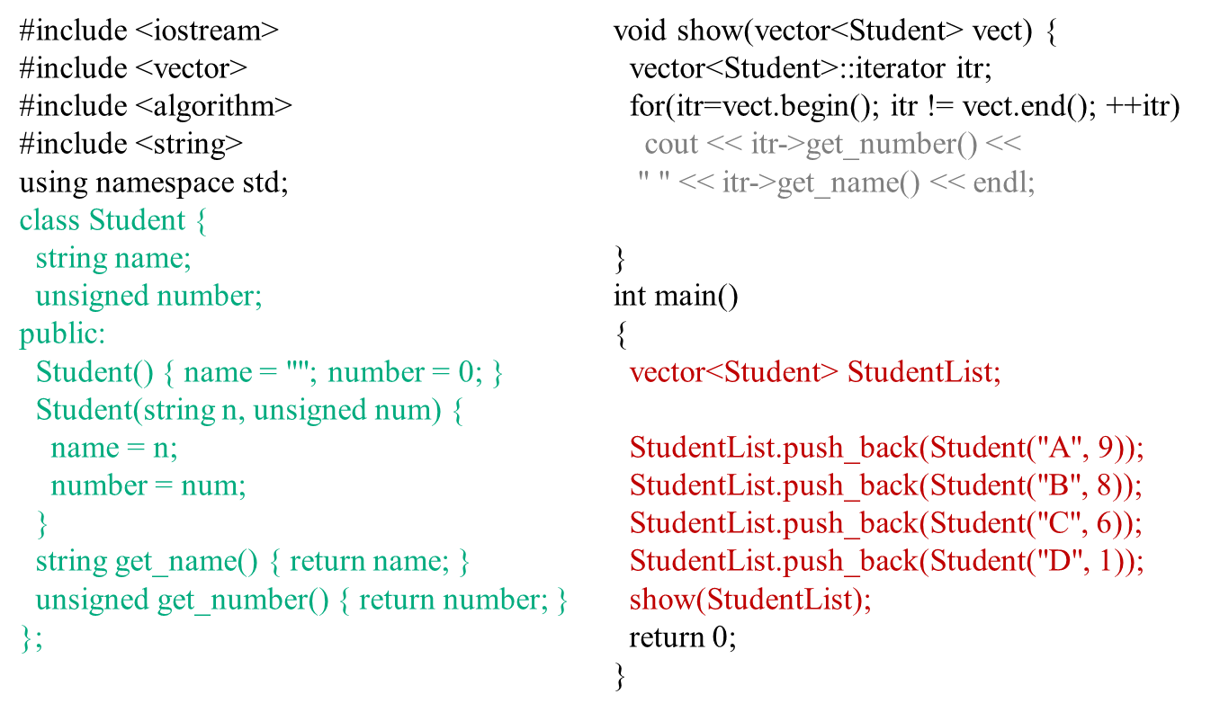
Storing User Defined Objects in Vectors
with the STL is that you can use it to store and manipulate objects of classes that you write

Slide 87
Function Objects
Functors (Function Objects or Functionals) are simply put object + ().
In other words, a functor is any object that can be used with () in the manner of a function.
This includes normal functions, pointers to functions, and class objects for which the () operator (function call operator) is overloaded, i.e., classes for which the function operator()() is defined.
Sometimes we can use a function object when an ordinary function won't work. The STL often uses function objects and provides several function objects that are very helpful.
Function objects are another example of the power of generic programming and the concept of pure abstraction. We could say that anything that behaves like a function is a function. So, if we define an object that behaves as a function, it can be used as a function.

Slide 88
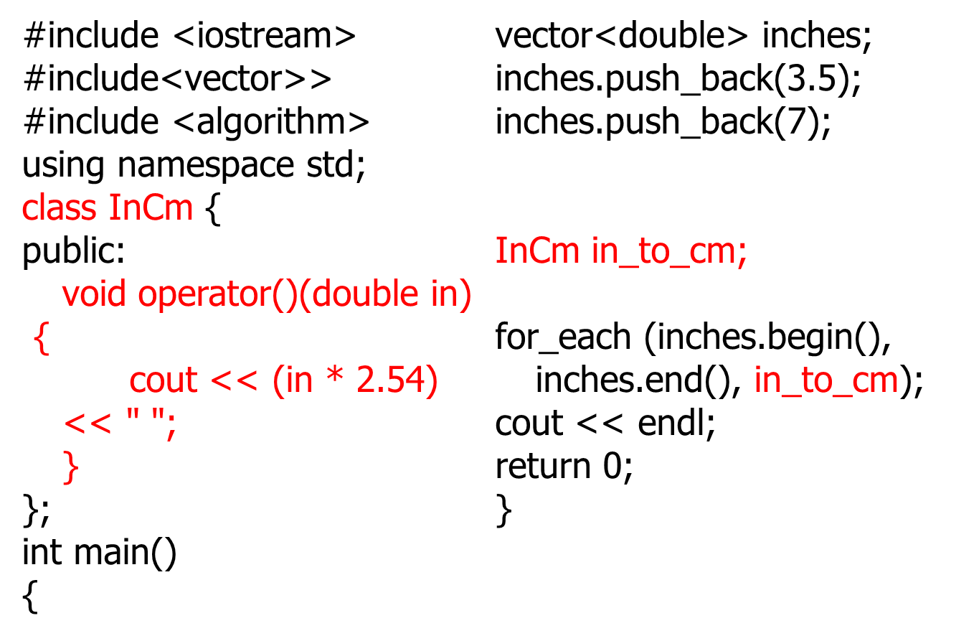
Function Objects

Slide 89
Advantages of function object
Function object are "smart functions."
Each function object has its own type.
Function objects are usually faster than ordinary functions.

